Slide 1

Iterative Ideas
Activity 3

Slide 2

Innovation

Slide 3
Answer: Questions 1-3
1) Innovation is the process of creating something new and unexpected. Why is it important to be innovative in the STEM Challenge?
2) Think back to a time in your life when you had creative freedom and came up with a new innovative idea. Describe this experience.
3) How do you use sources to figure out if your solution is new and innovative?

Slide 4
Discuss: Answers to Questions 1-2
5
Time's Up!
4
3
2
1
Notes:
The five minute timer will begin upon click.
In describing their experiences when sharing their answers to Question 2, students may describe their feelings during the innovation process, why the situation necessitated innovation, or the steps they took in their innovation process. If students are not describing their feelings, situations, and steps, use the following guiding questions:
Why were you innovating?
What did you do to innovate?
How did you feel while innovating?
Were there any challenges while innovating?
Was your innovation a success?

Slide 5
Share: Answer to Question 3
Notes:
To help students identify that articles must also be recent, use the following guiding question:
When looking at an article, what piece of information can tell you if it is currently relevant to its field of study?

Slide 6
Engineering Design Process

Slide 7
Brainstorm: The steps of the engineering design process

Slide 8
Write: Each step of your engineering design process on a separate sticky note

Slide 9
Create: An engineering design process using your sticky notes
Work as a class to create one engineering design process.

Slide 10
Discuss: The Engineering Design Process
5
Time's Up!
4
3
2
1
Notes:
The five minute timer will begin upon click.
If any groups have created a linear design flow, ask students one of the following guiding questions:
Does anyone have a sticky note indicating a final product? If there are no “end” products, can you put your sticky notes in a straight line?
If there is a final product, do you think everyone in the room will agree that they cannot improve upon it? If the answer is no, then it is not a final product.
Other guiding questions to facilitate the discussion are as follows:
Did everyone agree on each step of the engineering design process?
Did you remove or combine any steps when creating your engineering design process?
Did you add any steps when creating your engineering design process?
What steps were the most common?

Slide 11
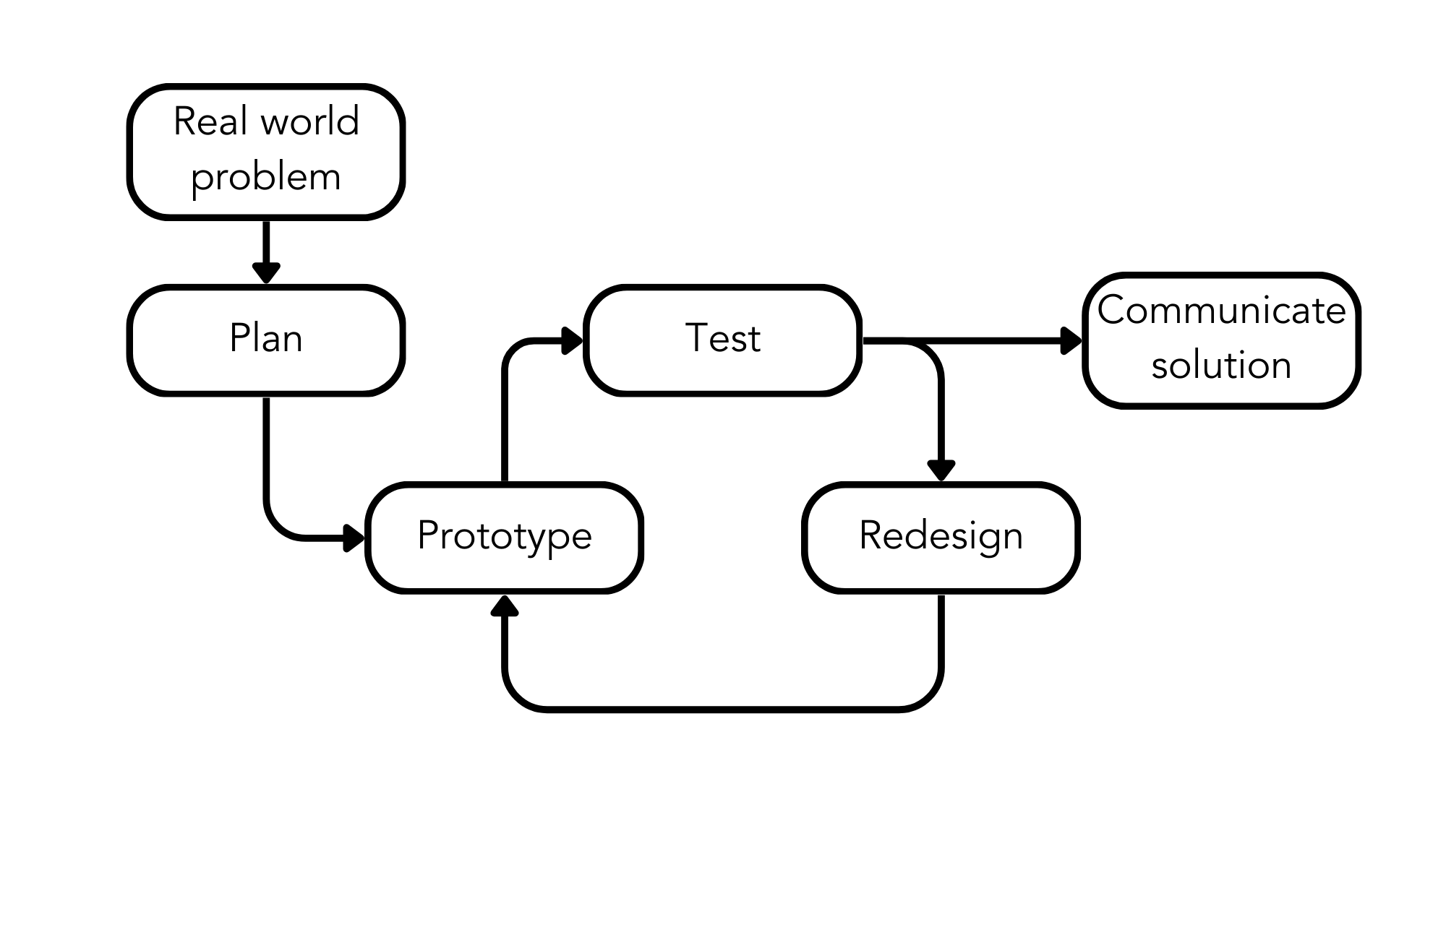

Slide 12
Discuss: How can you “test” your solution during the STEM Challenge?
Time's Up!
3
2
1
Notes:
The three minute timer will begin upon click.
If students are struggling to answer the question, ask students one of the following guiding questions:
What might scientists or researchers do before starting an experiment?
How would a researcher “test” a design or solution for effectiveness before implementation?
What “tests” could identify problems within your solution?

Slide 13
Discuss: How was your engineering design process different from the process we are using?
5
Time's Up!
4
3
2
1
Notes:
The five minute timer will begin upon click.
Use the following guiding questions to help facilitate the discussion:
Are there any steps in this engineering design process that you did not include when brainstorming?
Are there any steps you brainstormed not present in this engineering design process?
Did you create a different number of steps from this engineering design process? If so, why do you think they might be different?

Slide 14
Answer: Questions 4-5
4) How does the engineering design process facilitate innovation?
5) What does it mean to make multiple iterations of something? Why is it important?

Slide 15
Share: Answers to Questions 4-5

Slide 16
Move: If you are working in a group, move to go sit with your group members.

Slide 17
Answer: Questions 6-10
6) What part of the engineering design process are you currently on? If applicable, how many times have you been through the engineering design process?
7) Why is the engineering design process often collaborative?
8) How can a one-person project be made collaborative?
9) How will you collaborate effectively?
10) At what point do you decide you are done iterating on your solution? In theory, the engineering design process never ends.

Slide 18
Share: Answer to Question 9

Slide 19
Discuss: Answer to Question 10
5
Time's Up!
4
3
2
1
Notes:
The five minute timer will begin upon click.
The following guiding questions may be used to facilitate the discussion:
Is there a tangible end point to the engineering design process?
Is it possible to have a perfect solution?
Why is it important to find a temporary endpoint?
What might happen if you iterate on your idea indefinitely?

Slide 20
Continue to work on your STEM Challenge!

