Slide 1
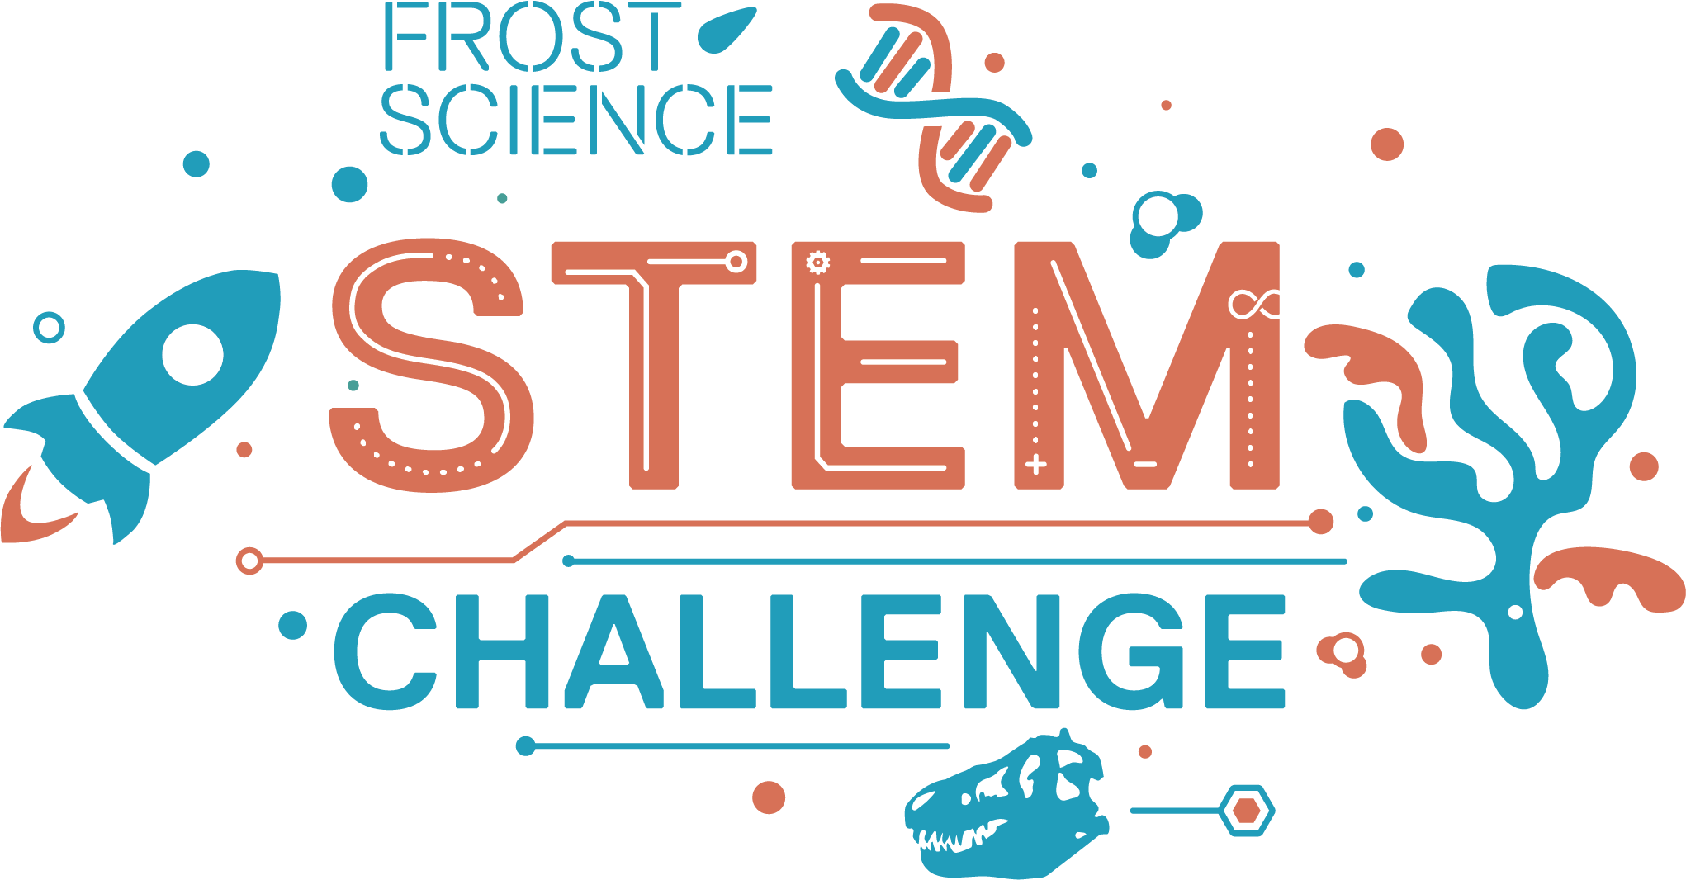
Sound Sources
Activity 2

Slide 2
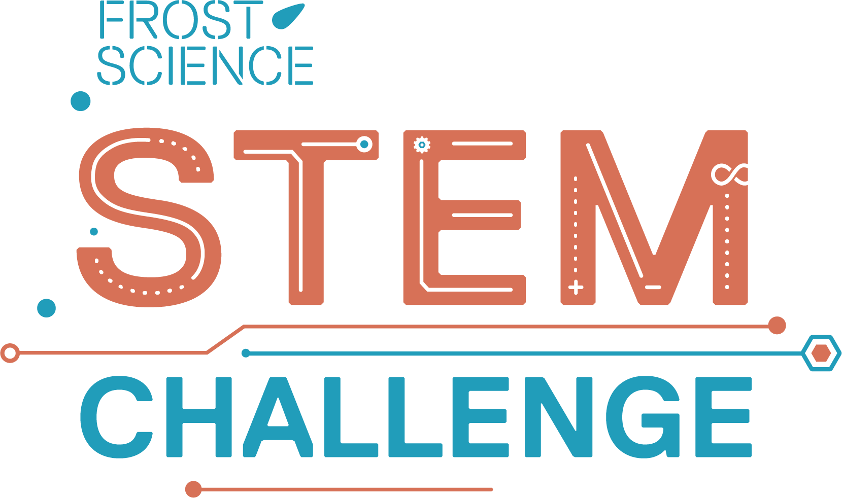
Sound Sources

Slide 3
Grab: Your sources for the STEM Challenge
If you are working in a group, move to go sit with your group members.

Slide 4
Share: How do you feel about your sources?
Notes:
Ask students to show how they feel about their sources by giving either a thumbs up or thumbs down.
Ask several students, from separate groups, to share the reason behind their response. If a student mentions having difficulty finding strong/good/reliable sources, highlight their answer and move to the next slide.
If no students mention having difficulty finding strong/good/reliable sources, ask students one of the following guiding questions:
Are there any other reasons why someone may feel bad about their sources?
Is there any possibility you could be using a source that provides inaccurate information?
If students have not begun to research their prompt, skip to the next slide.

Slide 5
Write: What make a source “bad” or “good?”
List the traits of "bad" and "good" sources on a piece of scrap paper
Time's Up!
2
1
Notes:
The two minute timer will begin upon click.

Slide 6
Identify: 3 reliable and 3 unreliable sources
Notes:
This should be completed individually and silently. Tell students to justify each of their answers and to not to share their answers with anyone. Do not define reliable or unreliable for students.

Slide 7
Reliable Sources

Slide 8
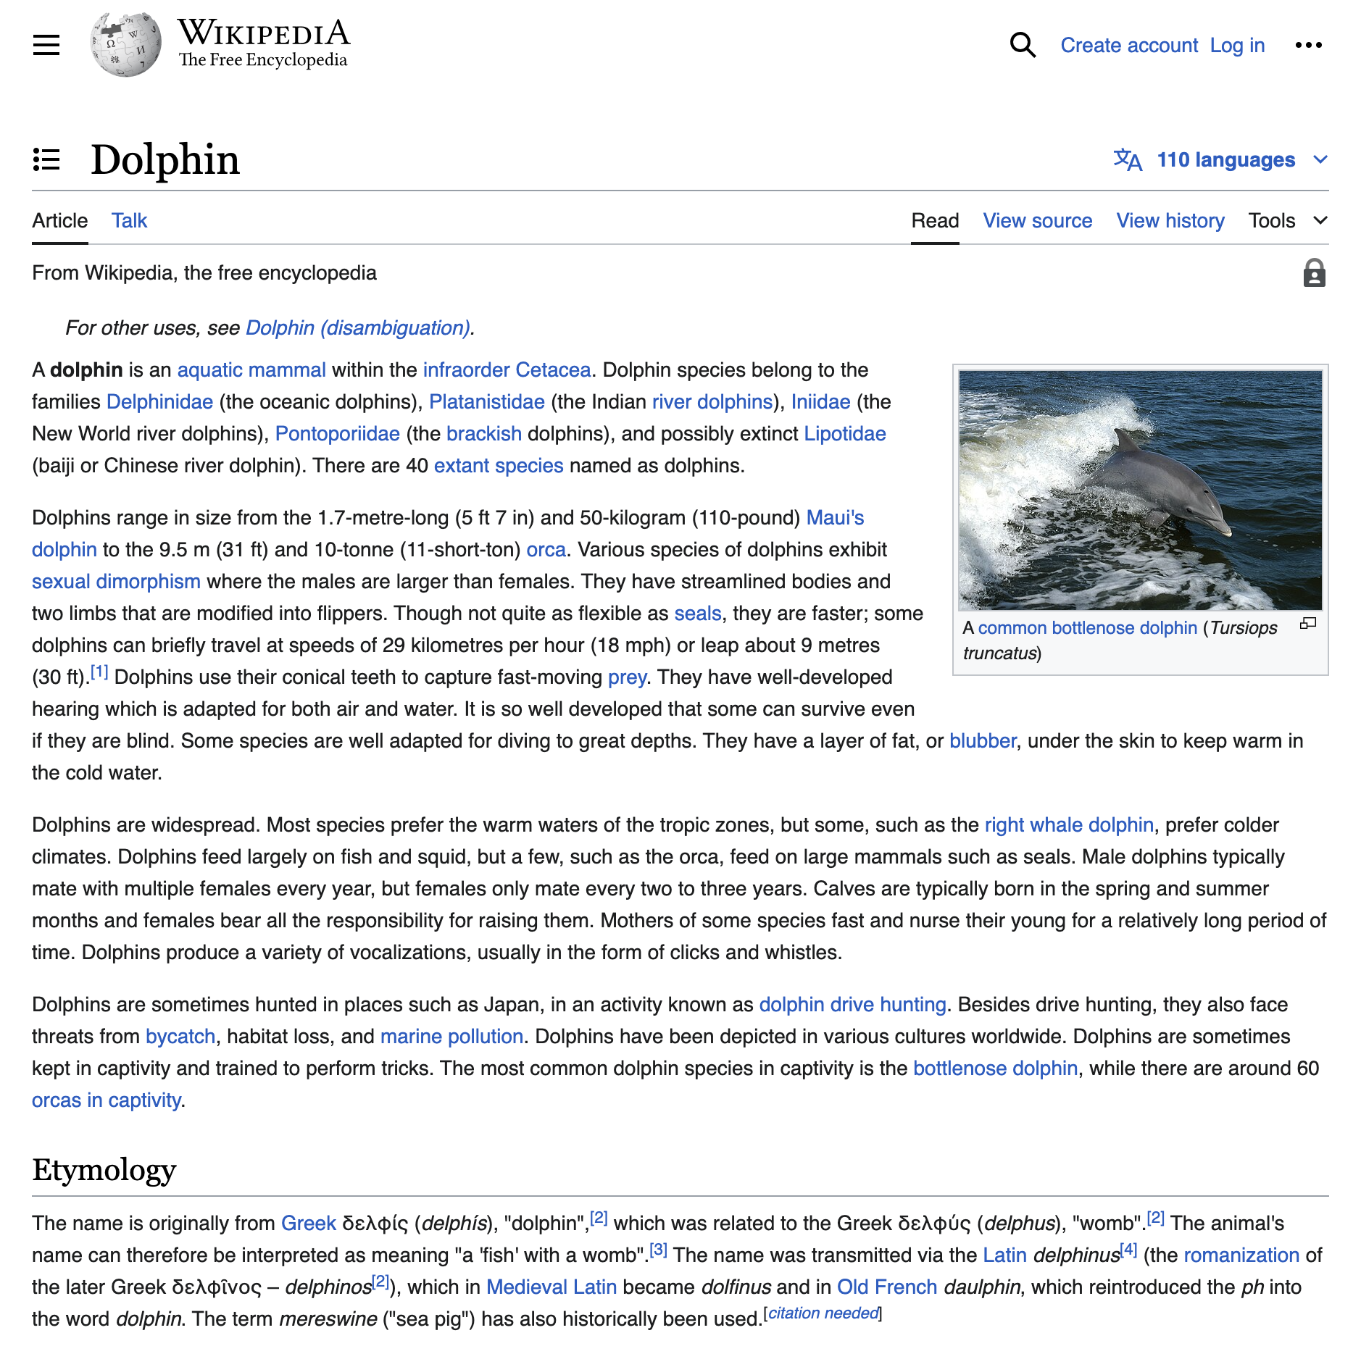
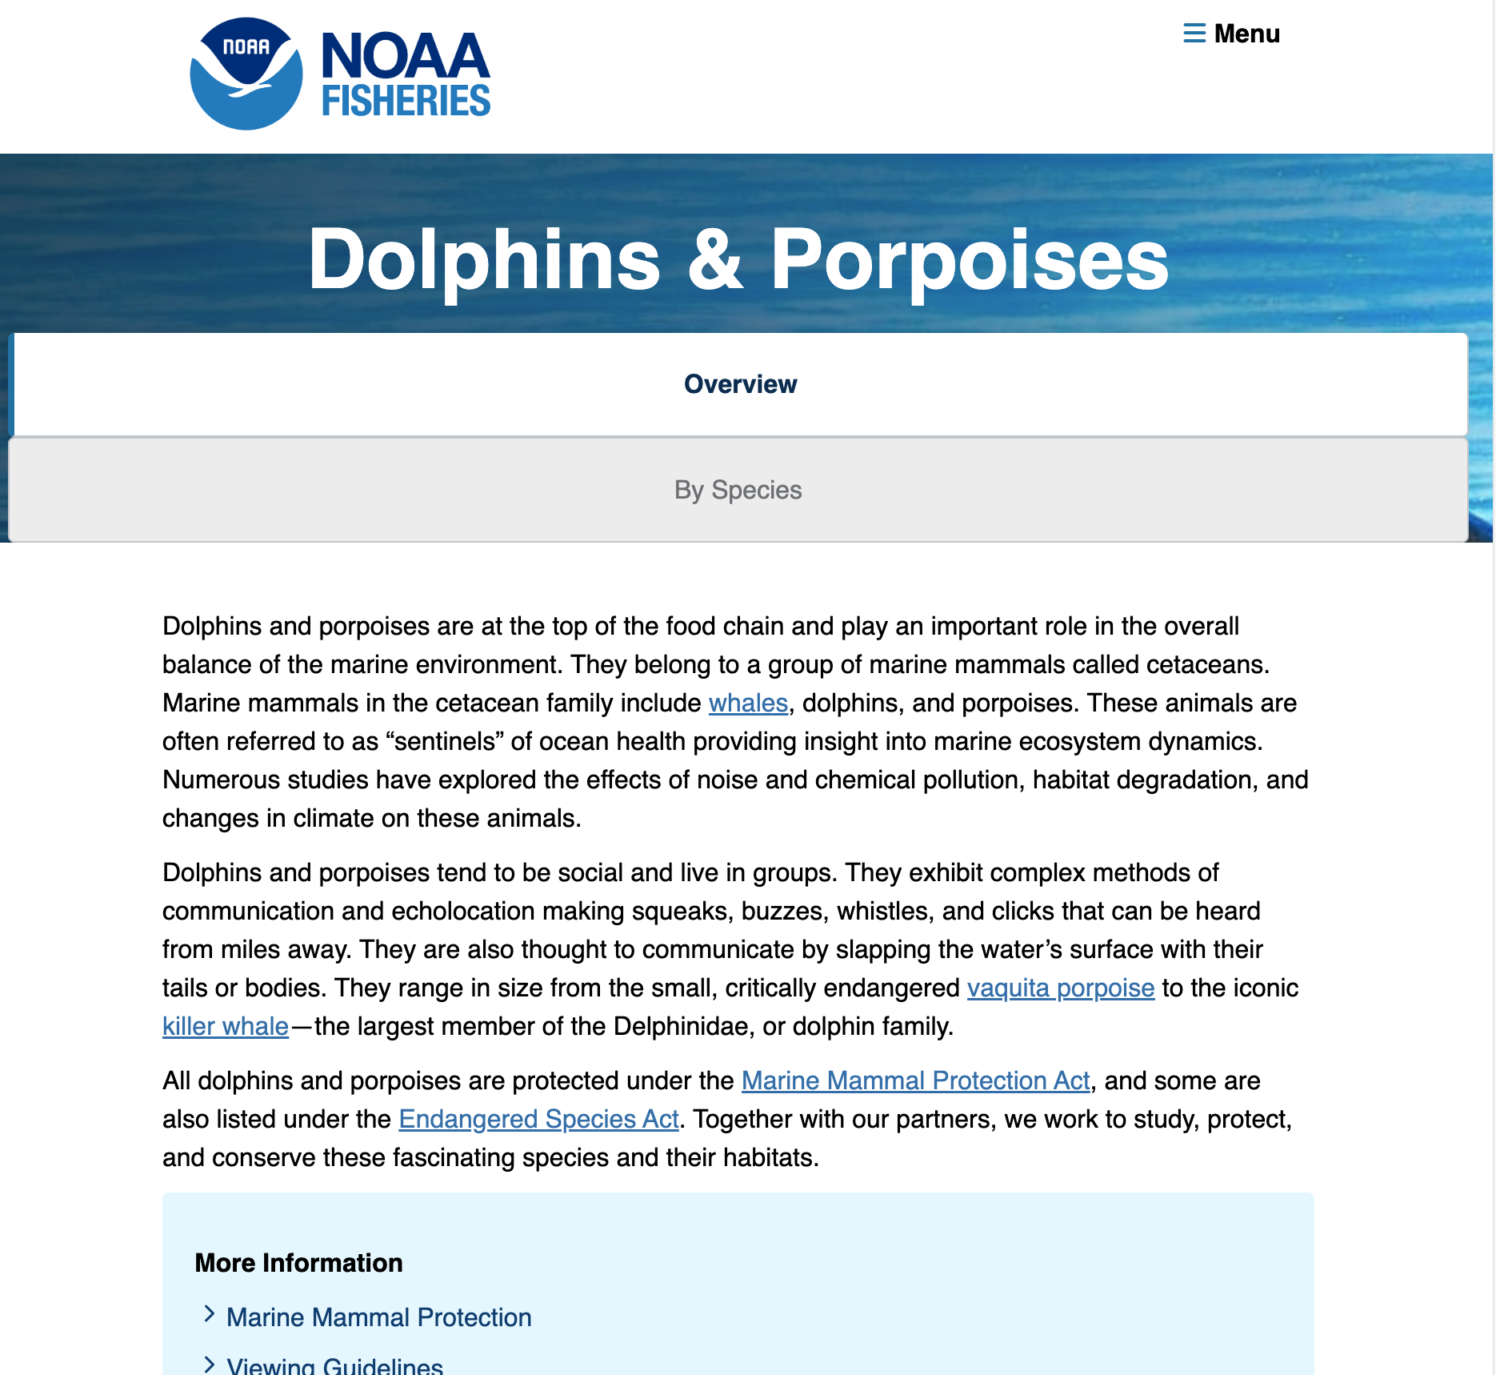
Learn: Unreliable vs. Reliable Sources
Unreliable Source
Reliable Source

Slide 9
Answer: Questions 1-3
1) How can you tell which source is reliable and which source is unreliable? What sets the reliable source apart from the unreliable source?
2) What does it mean if something is reliable?
3) What is the importance of using reliable sources in your STEM Challenge?

Slide 10
Share: Answers to Questions 1-3

Slide 11
Answer: Question 4
4) Reliable sources should remain unbiased. Imagine that you are researching the relationship between screen-time and mental health and find two articles of interest. One article is written by a psychologist and published in a medical journal, whereas the second article is written by a video game company and published on the video game designer's website.
What does it mean if a source is biased? Which article is biased? How can you tell?

Slide 12
Discuss: Answer to Question 4 and Bias
5
Time's Up!
4
3
2
1
Notes:
The five minute timer will begin upon click.
To help facilitate this discussion, you may ask the following guiding questions:
What is the relationship between reliability and bias?
Is bias intentional?
Why might someone not recognize their own bias?
Why might someone be intentionally biased?
Why is bias dangerous?

Slide 13
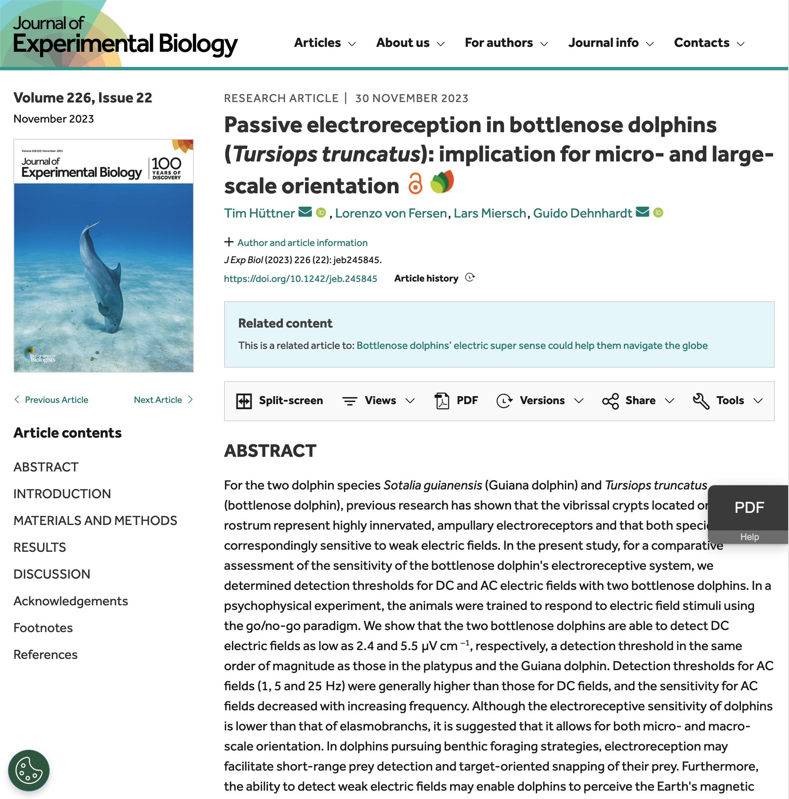
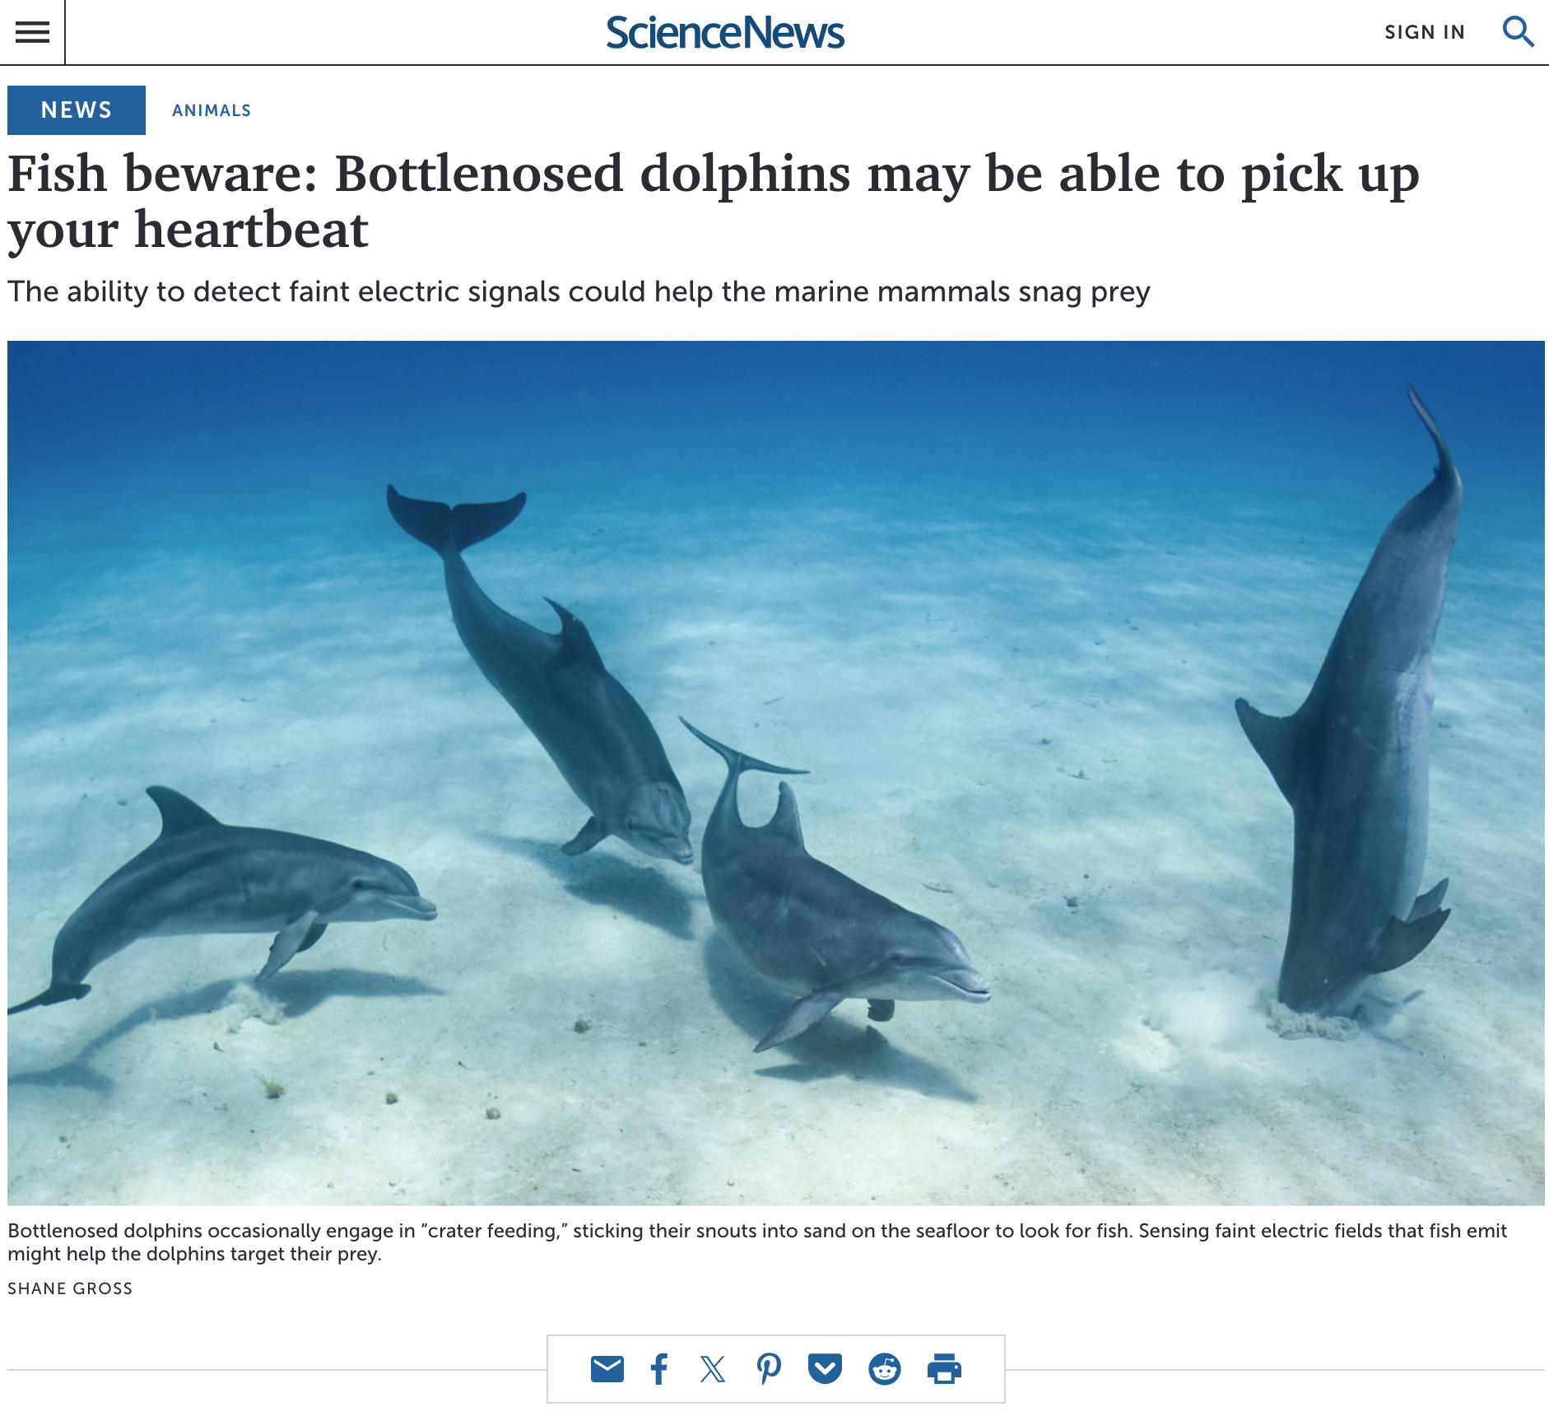
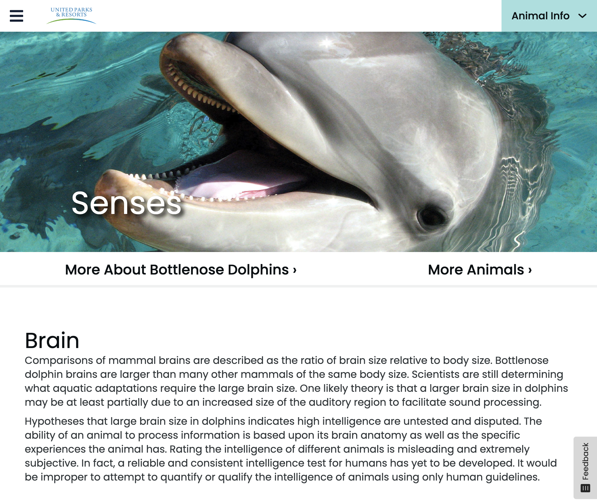
Learn: Types of Sources
Primary
Secondary
Tertiary

Slide 14
Answer: Questions 5-6
5) Look at each of the provided sources and take note of any differences. Why might we designate sources as primary, secondary, or tertiary sources? What do you think these designations might mean?
6) We often consider primary and secondary sources to be reliable sources. Why might we not consider tertiary sources reliable?

Slide 15
Share: Answers to Questions 5-6
Notes:
If students are struggling to answer question 5, use the following guiding questions:
Would the primary, secondary, or tertiary source be the original source of information?
If the primary sources are the original source of information, what might it mean if something is a secondary source?
Using the same thought process, what might it mean if something is tertiary source?

Slide 16
Answer: Questions 7-12
7) What type of source are scientific articles? Why?
8) What are the advantages of using scientific articles in your project?
9) What must a scientific experiment do to be considered reliable and scientifically accurate?
10) Can scientific articles be biased? If so, what might a biased scientific article look like?
11) How could a reliable, unbiased scientific article provide misinformation?
12) What can you do to make sure that your sources, including any scientific articles, are providing accurate information?

Slide 17
Review: Answers to Questions 7-12

Slide 18
Using Google Scholar
Notes:
If students have access to their computers, ask students to follow along.

Slide 19
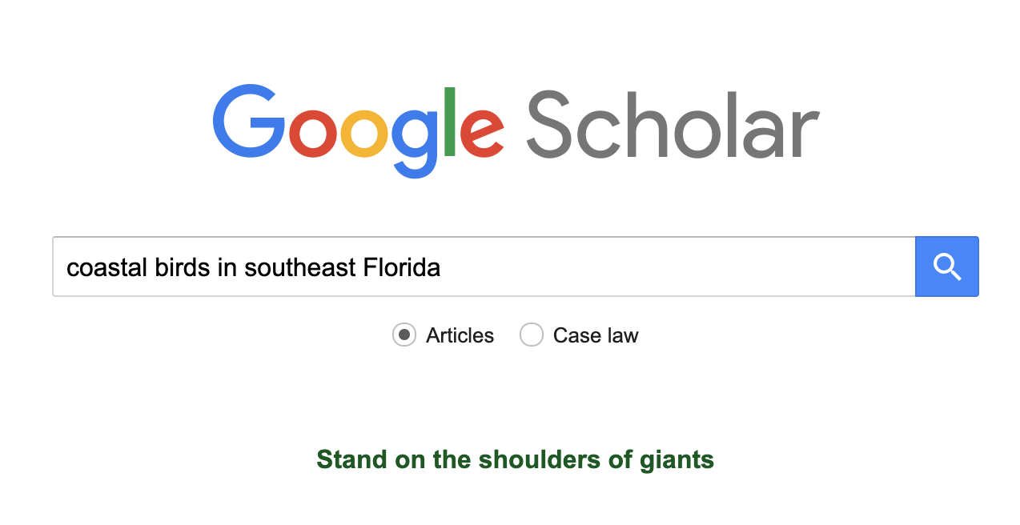
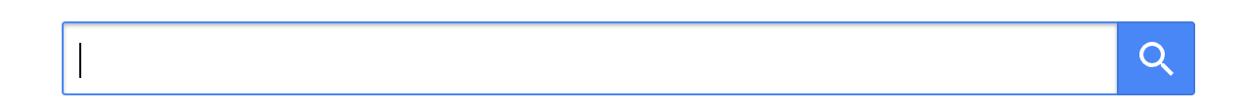
Step 1: Go to Google Scholar

Slide 20
Step 2: Enter a Search Query

Slide 21
Share: Why it is important to use a specific search query instead of something vague like “birds” or “birds on the beach?”

Slide 22
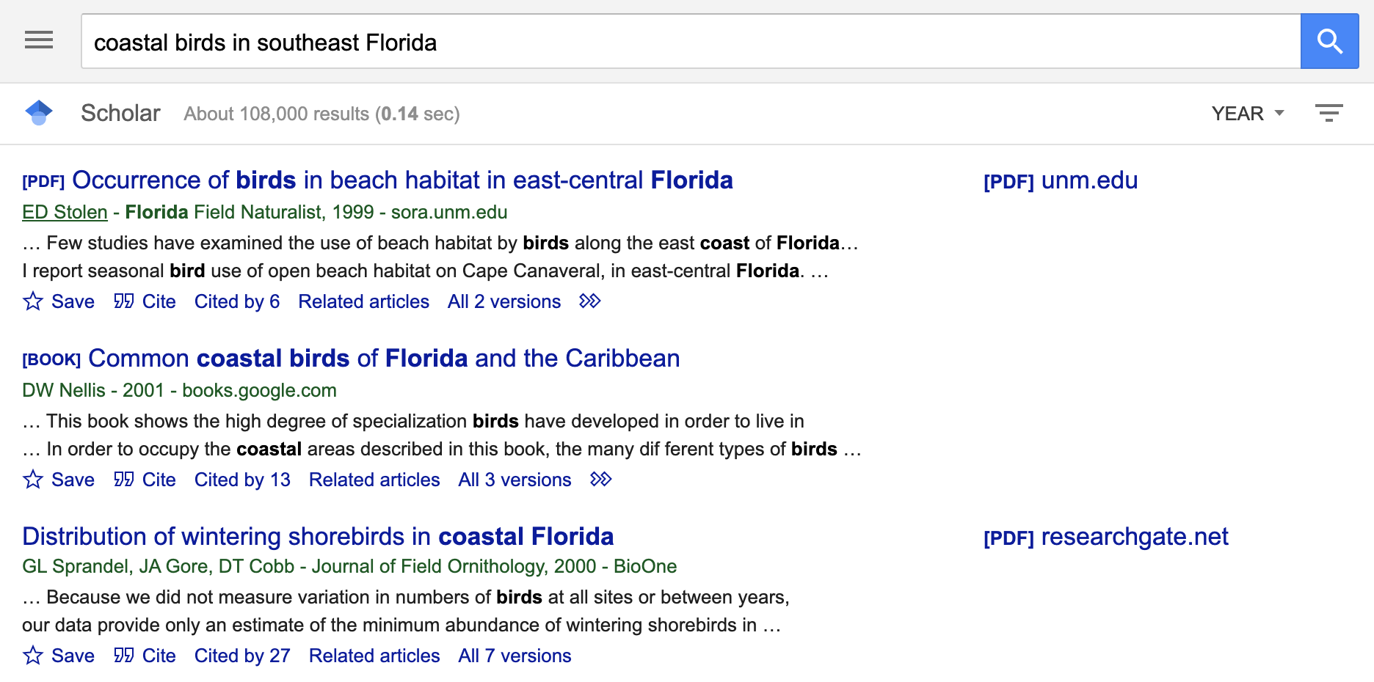
Step 3: Search

Slide 23
Step 4: Read the Titles

Slide 24
Step 5: Check the Dates
Notes:
If students ask about this step of the procedure, let students know that old articles are not necessarily unreliable. They should not discount an article because of it's age. However, newer articles are more likely to have updated, relevant information.

Slide 25
Step 6: Identify Titles with a PDF
Notes:
Using the PDFs allows students to bypass any potential paywalls. While research articles can sometimes be accessed through the website, they are frequently either partially or fully locked behind a paywall.

Slide 26
Step 7: Find a Recent, Relevant Article
(with a PDF)

Slide 27
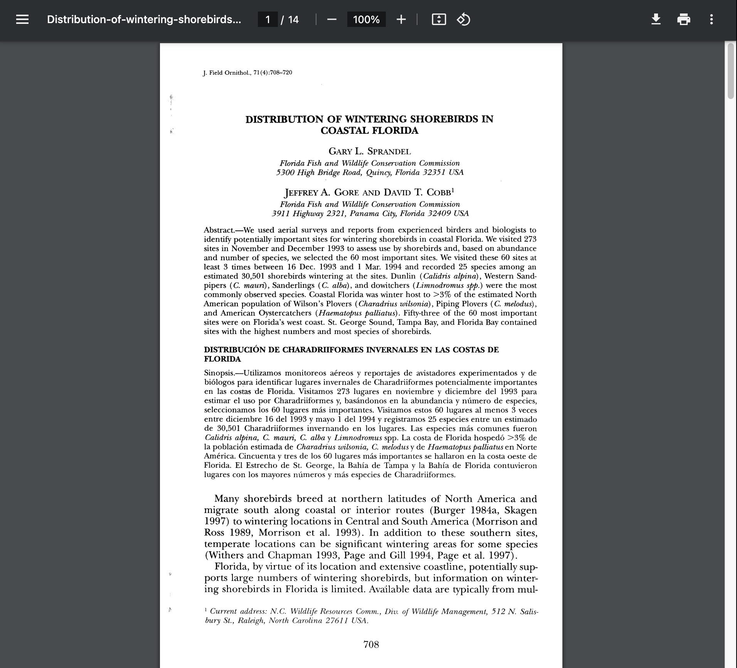
Step 8: Open the PDF

Slide 28
Answer: Questions 13-16
13) What kind of search query might you use to find scientific articles for your project?
14) Using your search query, look at the titles of each study to find one you think would provide helpful information. Looking at this article, what is the purpose of the abstract?
15) After reading the abstract, there are two other sections of the research paper that are important to read. What sections do you think you may need to read to understand the study? Explain your answer.
16) In what situation would you sit down to read the remaining sections of the research paper?

Slide 29
Share: Answers to Questions 13-16
Notes:
If students are struggling to answer questions 14 and 15, ask students the following guiding questions:
What part of the article is going to give you the basic information needed to understand the article?
What part of the article explores what the researchers learned from their experiment?

Slide 30
Correct: 3 reliable and 3 unreliable sources
Notes:
Ask students to return to the list of 3 reliable and 3 unreliable sources they created at the beginning of the activity. Ask students to analyze their list and make corrections if needed.

Slide 31
Play: Two Reliable and an Unreliable
"Two truths and a lie"
Notes:
Ask students to turn and share two of their reliable sources and one of their unreliable sources with a partner. To share their resources, students should open each resource on their computer to show their partner. Like “two truths and a lie,” the partner will have to guess which source is the unreliable source. This could be a biased source, a source containing misinformation, or a tertiary source.

Slide 32
Review: Your STEM Challenge Sources!
Remove any biased or tertiary sources
Note: Tertiary sources might be able to point you to unbiased primary or secondary sources
Notes:
If students have not begun to research their prompt, skip to the next slide.

Slide 33
Citing Sources

Slide 34
Learn: APA Format
Created by the American Psychological Association (APA) in 1929 to standardize writing formats across the scientific community.
Bibliography or Sources sections must list APA citations in alphabetical order.
Most of the cited works used in the STEM Challenge will be websites. These websites can be cited as follows:
Lastname, F. M. (Year, Month Date). Title of page. Site name. URL

Slide 35
Learn: APA Citations
Most of the cited works used in the STEM Challenge will be websites or scientific articles.
Websites can be cited as follows:
Lastname, F. M. (Year, Month Date). Title of page. Site name. URL
Scientific articles can be cited as follows:
Lastname, F.M. (Year). Title of article. Journal name, volume number(issue number), pages. URL
If you are not using a website or scientific article, you will cite your sources using a different format
Option 1: Use the APA website to find the correct format
Option 2: Use a citation generator to make your APA citation

Slide 36
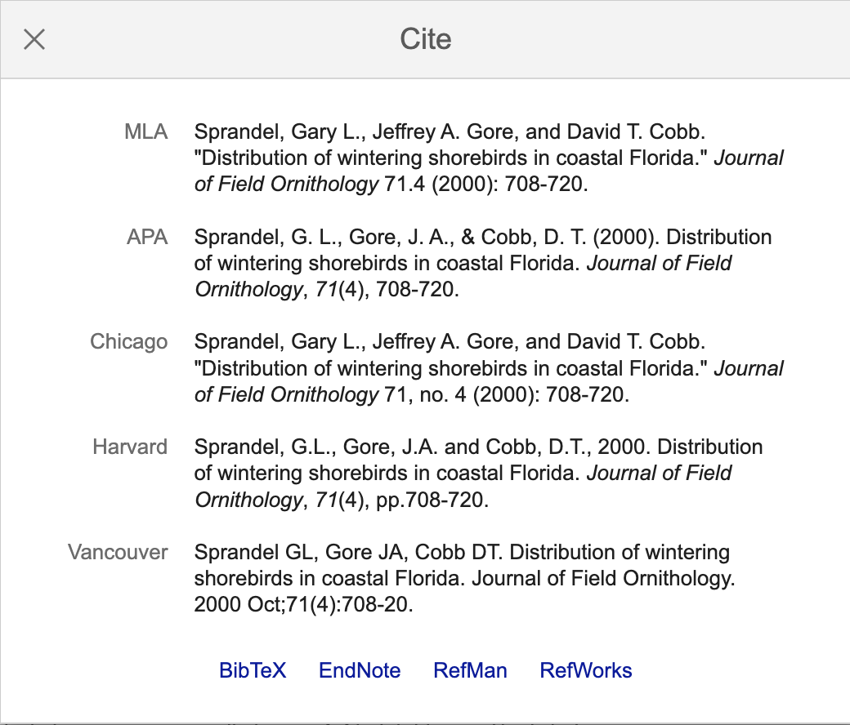
Learn: Using Google Scholar to Cite

Slide 37
Learn: APA In-Text Citations
In-Text Citations
No author | (Title of Source, Year)
One author | (Last name of Author, Year)
Two authors | (Last name of Author 1 & Last name of Author 2, Year)
More than one author | (Last name Author 1 et al., Year)
If citing multiple works | (In-text citation 1; In-text citation 2)
Whenever you reference information from one of your sources, you need to include an in-text citation.
In scientific articles, direct quotations are rarely used and most information from other sources is paraphrased.
Direct quotations must include the page number at the end of the in-text citation:
p. #

Slide 38
Review: APA In-Text Citations Examples
Paraphrased (preferred): In the 1990s, Florida's west coast was observed to have a higher wintering shorebird biodiversity than Florida's east coast (Sprandel et al., 2000).
Direct Quote: "Fifty-three of the 60 most important sites were on Florida's west coast. St. George Sound, Tampa Bay, and Florida Bay contained sites with the highest numbers and most species of shorebirds" (Sprandel et al., 2000, p. 708).

Slide 39
Look for sources for your STEM Challenge!

